Slide 1

Spam Detection Using NLP
Applying NLP Techniques to Classify SMS Messages
Group 29: Zihan Wang
Date: December 6, 2024

Slide 2

Introduction
Problem in Email:
- Managing unsolicited spam messages in communication systems.
Objective:
- Build a machine learning model to classify SMS messages as spam or non-spam.

Slide 3
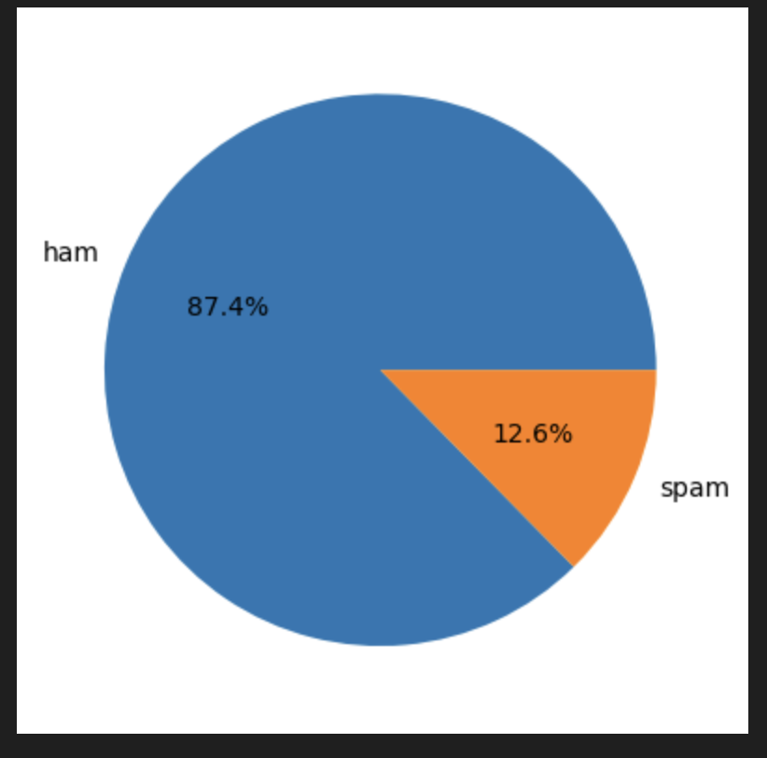
Data Cleaning and Preparation
Source: SMS Spam Collection Dataset
Total Messages: 5,572 (Reduced to 5,169 after cleaning)
Features:
  Original Text
  Label (ham or spam)
Key Challenge: Dataset imbalance (More ham than spam).

Slide 4
Preprocessing
Steps Taken:
Removed duplicates and unnecessary columns.
Label encoding (ham → 0, spam → 1).
Text transformations:
  Lowercasing
  Tokenization
  Removing stop words and punctuation
  Stemming
Outcome: Cleaned and transformed text ready for vectorization.

Slide 5
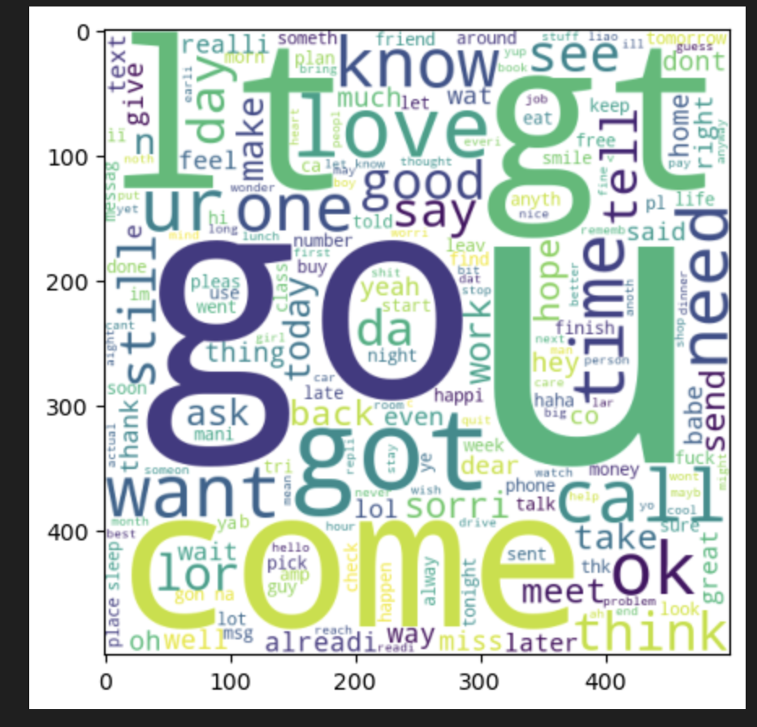
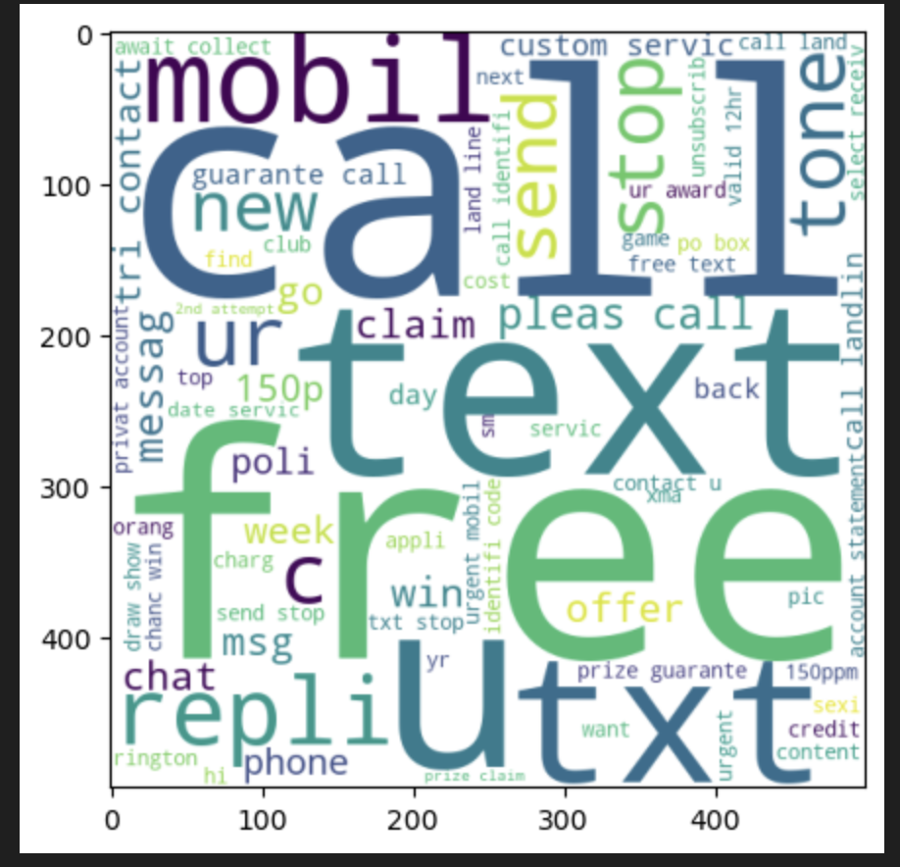
Exploratory Data Analysis (EDA)
Key Findings:
Spam messages are longer (more characters, words, sentences).
Word clouds showed common spam terms like "free", "win", and "urgent".
Visualization Examples:
Pie chart of ham vs. spam distribution.
Histograms for message lengths.

Slide 6
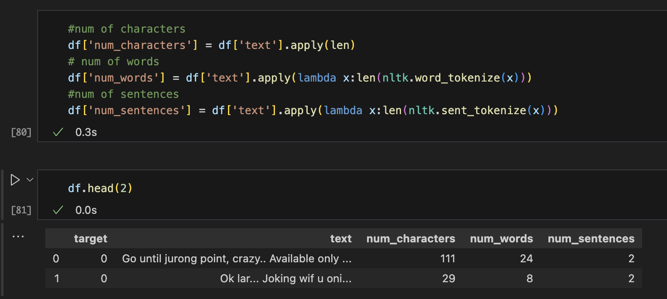
Feature Engineering
Added columns for:
  Character count
  Word count
  Sentence count

Slide 7
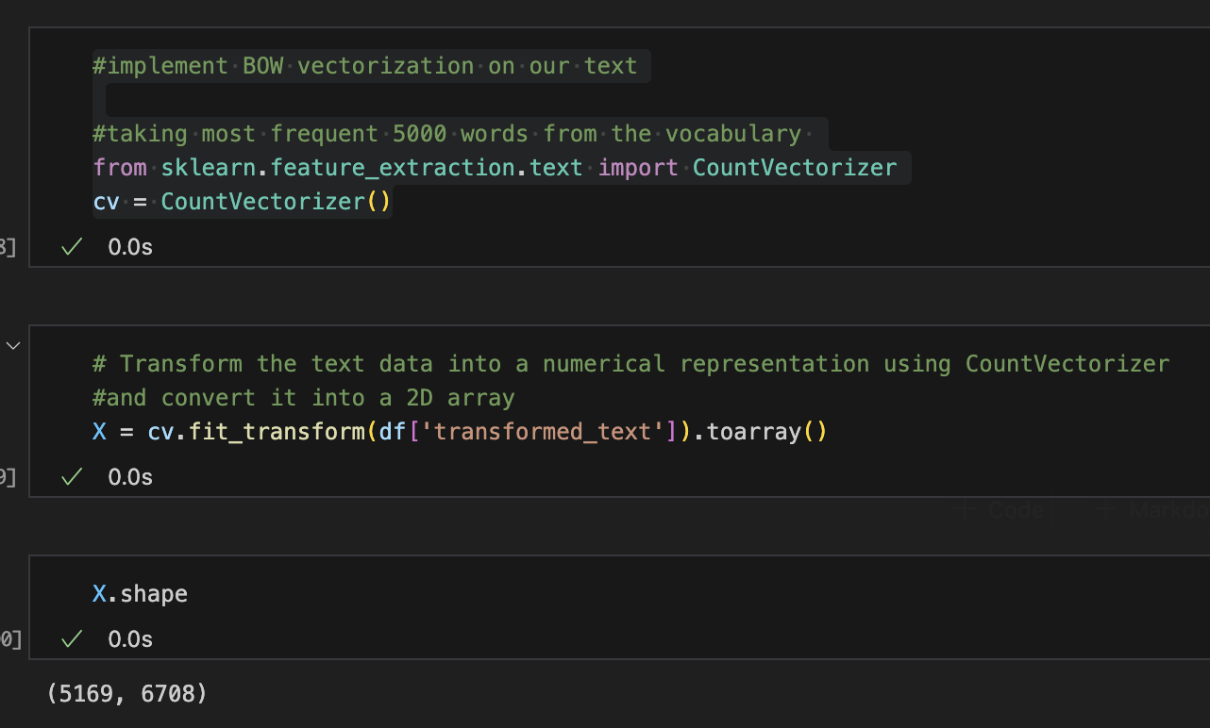
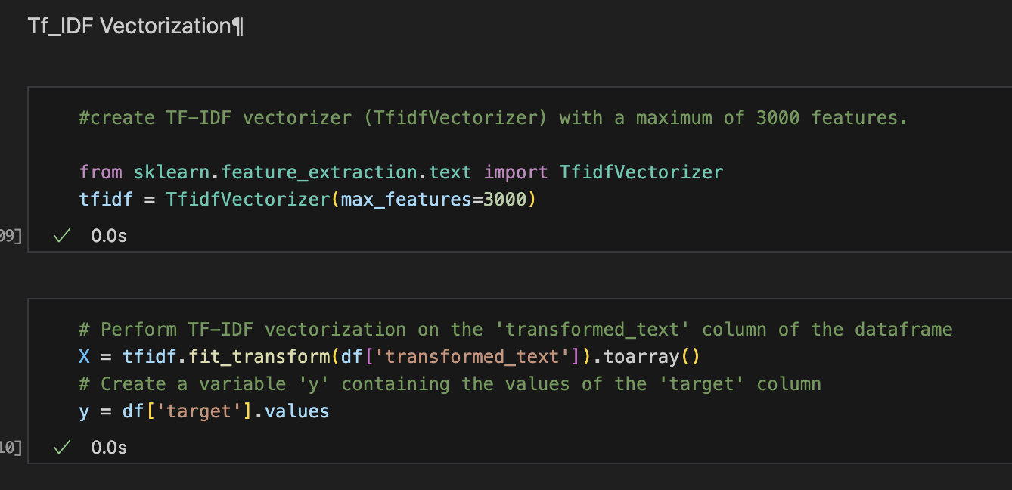
Vectorization Techniques
Bag of Words (BoW): Simple word frequency.
TF-IDF: Highlighted important terms by balancing frequency and rarity.

Slide 8
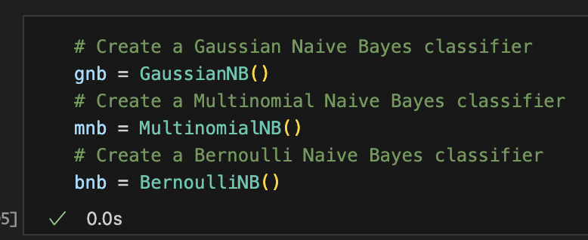
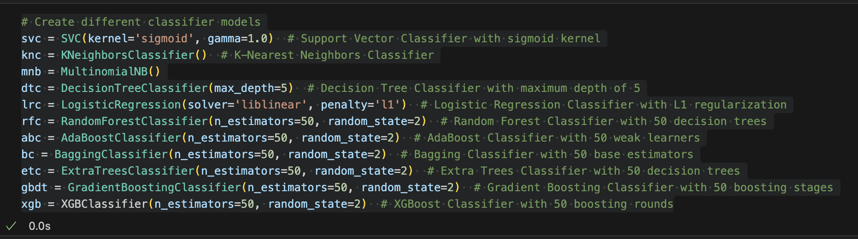
Algorithms Tested
Naive Bayes Variants:
  Gaussian, Multinomial, Bernoulli
Other Classifiers:
  Logistic Regression
  SVM
  Random Forest
  Gradient Boosting
  XGBoost

Slide 9
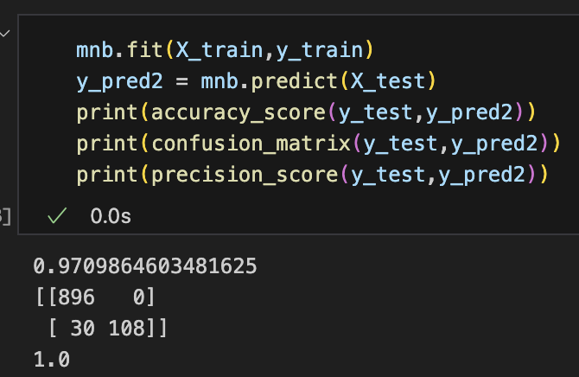
Model Performance
Best Model: Multinomial Naive Bayes with TF-IDF
  Accuracy: 97.09%
  Precision: 100%
Runner-Up: Bernoulli Naive Bayes
  Accuracy: 98.16%
  Precision: 99.17%
  Other models like SVM and Random Forest performed well but fell short of Naive Bayes in precision.

Slide 10
Discussion
Why Naive Bayes?
  Computationally efficient.
  High precision and recall on text classification tasks.
Limitations:
  Dataset imbalance impacts recall.
  Requires continuous updating for evolving spam patterns.

Slide 11
Future Work
Expand Dataset: Include more diverse and recent data.
Experiment with Deep Learning: LSTM or Transformers.
Hybrid Models: Combine Naive Bayes with others for improved performance.
Real-Time Testing: Deploy in live environments.

Slide 12
Conclusion
Achievements: Developed a robust spam detection system.
Outcome: High accuracy and perfect precision with Multinomial Naive Bayes and TF-IDF.
Next Steps: Broaden dataset and refine models.

Slide 13

Thank you for listening
Q & A

